Slide 2
Absence of Copyright
This slideshow contains photos, diagrams, and information, some of which were attained through internet searches of public websites. The author of this presentation does not own the copyright on this information, so this slideshow is for personal use only—not for sale or profit. Please utilize it to seek the Lord and grow in your knowledge of His Word and ways.

Slide 4
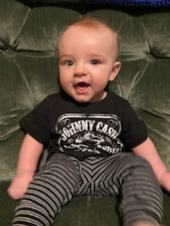
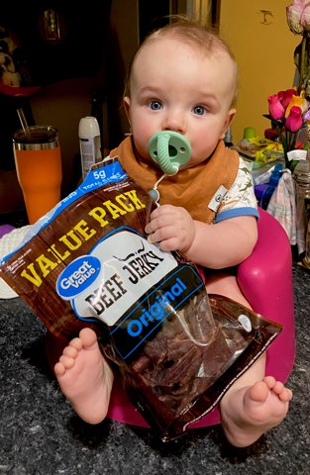
Double dose of Noah again tonight

Slide 5
Prayer and Announcements
Sunday: 9:15 Fellowship
9:30 SS Master Class
10:30 Worship
Revelation Study available on our church website
www.faithprinceton.org
Email questions and comments to
pastor@faithprinceton.org

Slide 6
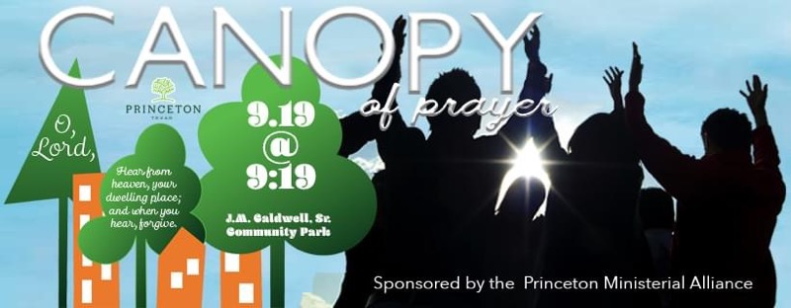

Slide 8
END HERE SEPTEMBER 2, 2020
LAST WEEK 17 Revelation 12
The Woman, The Child, and the Dragon
BEGIN HERE SEPTEMBER 16, 2020
WEEK 18 Revelation 12b - 13

Slide 9
Revelation 12:10-11 Victory Cry
10 Then I heard a loud voice in heaven, saying,
“Now the salvation, and the power, and the kingdom of our God and the authority of His Christ have come, for the accuser of our brethren has been thrown down, he who accuses them before our God day and night. 11 And they overcame him because of the blood of the Lamb and because of the word of their testimony, and they did not love their life even when faced with death.
Notes:
Now... Have come... Salvation, power, kingdom, authority... Chapter 13 will talk about the authority of the Antichrist and the Beast and the False Prophet ➔ all are derived authority!!
Accuser = accuses them before God day and night!! Wearing out the courtroom!! But one day—NO MORE!!
Overcame = níkē, "victory" – ➔➔

Slide 10
Revelation 12:10-11 Victory Cry
Verse 11 ...
Overcame = níkē, "victory") - properly,
conquer; overcome; " 'to carry off the victory, come off victorious.' The verb implies a battle.
The blood of the Lamb
The Word of their testimony = μαρτυρίας : witness, evidence, testimony, reputation...
Did not love their life = No fear of death!!!
Notes:
Now... Have come... Salvation, power, kingdom, authority...
Overcame = níkē, "victory") – properly, conquer (overcome); " 'to carry off the victory, come off victorious.' The verb implies a battle"
By the blood of the Lamb = Not the blood of the dragon in forceful destruction of the dragon, but the Lamb shed His own blood... We stand on the Gospel... We win by aligning with Jesus... “Greater is He that is IN me than He that is in the world”
Because of the Word of their testimony = μαρτυρίας : witness, evidence, testimony, reputation... What defeats the accuser and deceiver is the TRUTH which sets men free!! The only weapon Jesus carries in Revelation is the sword in His mouth! We stand in the Authority of God’s Truth which set us free.
Did not love their life = No fear of death!!! No fear in Life!!! We love the Lord more than life itself!!! Satan cannot stand against that. Fear of death is one of his greatest weapons.... Man’s mortality drives him to extreme measures.

Slide 11
Revelation 12:12-13 Wrath of the Devil
12 For this reason, rejoice, O heavens and you who dwell in them. Woe to the earth and the sea, because the devil has come down to you, having great wrath, knowing that he has only a short time.”
13 And when the dragon saw that he was thrown down to the earth, he persecuted the woman who gave birth to the male child.
Notes:
12 For this reason, rejoice, O heavens and you who dwell in them.
Woe to the earth and the sea, because the devil has come down to you, having great wrath, knowing that he has only a short time.”
13 And when the dragon saw that he was thrown down to the earth, he persecuted the woman who gave birth to the male child.
Persecution of the church – the covenant community? Israel? The church?

Slide 12
Revelation 12:14-16 Protection for the Woman
14 But the two wings of the great eagle were given to the woman, so that she could fly into the wilderness to her place, where she *was nourished for a time and times and half a time, from the presence of the serpent. 15 And the serpent poured water like a river out of his mouth after the woman, so that he might cause her to be swept away with the flood. 16 But the earth helped the woman, and the earth opened its mouth and drank up the river which the dragon poured out of his mouth.
Notes:
SECOND EXODUS!!! (Ex. 19:4 “bore you on eagle’s wings”)
Leon Morris, Tyndale: Wilderness = a place of protection from a sea dragon!!
??? In this passage, the concept of a “flood” likely represents armies (see Isaiah 59:19; Jeremiah 46:7-8).
The earth is still under the control of God and accomplishes His purposes!!

Slide 13
Revelation 12:17 Watch Out Brothers!
17 So the dragon was enraged with the woman, and went off to make war with the rest of her children, who keep the commandments of God and hold to the testimony of Jesus.
Notes:
The Church is definitely the children of the woman!!!
who
keep the commandments of God and
hold to the testimony of Jesus
IN chapter 13 Satan will call up two helpers: the antichrist and the false prophet

Slide 14
Revelation 13 The Beast and the False Prophet
Notes:
Leon Morris, Tyndale Commentary on Revelation
13:1-18 The antichrist and his prophet The dragon, in his determination to annihilate the church, calls to his aid not one helper but two. The first beast comes out of the sea (1) showing its character as a sea monster like the dragon himself, and therefore demonic. The second beast comes out of the earth (11). This difference corresponds to that between behemoth the land monster (Jb. 40:15-24) and leviathan the sea monster (Jb. 41); in the prophetic and apocalyptic literature these creatures typify God–opposing powers (see e.g. Is. 27:1; 51:9; Ezk. 32). Consonant with this, the dragon, the beast from the sea and the beast from the land form a kind of evil trinity (see 16:13). Satan claims to be God; the antichrist is the christ of Satan; and the beast from the earth performs the function of an unholy spirit. The antichrist persuades the world to worship the devil; he has a fatal wound but lives (3), in a monstrous imitation of the Christ of God. The second beast seeks to persuade the world to worship the antichrist by his witness in word and deed, as the Holy Spirit witnesses to God’s Christ; and through the mark of the beast (itself a parody of the seal of God) he creates a devilish imitation of the church of Christ. So John depicts the world as divided between followers of the Truth and followers of the Lie.
8 The reference of the words from the creation of the world is uncertain; they can be linked with the slaying of [p. 1442] the Lamb (as in the AV, RV and NIV) or with the writing of names in the book of life (as in the JB, NASB and NRSV). Both meanings are equally true; for the former cf. 1 Pet. 1:19-20; for the latter Eph. 1:4. The difficulty is settled for most by appeal to 17:8, where almost identical language is used, linking the phrase with the writing in the book. Nevertheless, the word order here does not favour this interpretation, and it is best to keep to the NIV.

Slide 15
Revelation 13:1-2 The Beast from the Sea
1 And the dragon stood on the sand of the seashore.
Then I saw a beast coming up out of the sea, having ten horns and seven heads, and on his horns were ten diadems, and on his heads were blasphemous names. 2 And the beast which I saw was like a leopard, and his feet were like those of a bear, and his mouth like the mouth of a lion. And the dragon gave him his power and his throne and great authority.

Slide 16
Revelation 13:3-4 A Fatal Wound Healed
3 I saw one of his heads as if it had been slain, and his fatal wound was healed. And the whole earth was amazed and followed after the beast; 4 they worshiped the dragon because he gave his authority to the beast; and they worshiped the beast, saying, “Who is like the beast, and who is able to wage war with him?”
Notes:
As it it had been slain ➔ counterfeiting the death and resurrection of Jesus
Who is able ➔ one of the attractions of the Beast will be his power !!!

Slide 17
END HERE SEPTEMBER 2, 2020
END HERE SEPTEMBER 16, 2020
WEEK 18 Revelation 12b – 13
BEGIN HERE SEPTEMBER 23, 2020
REVELATION 13

